Slide 1
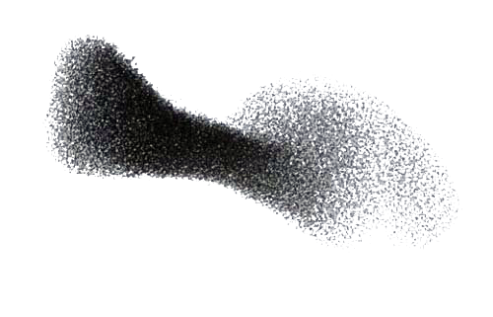
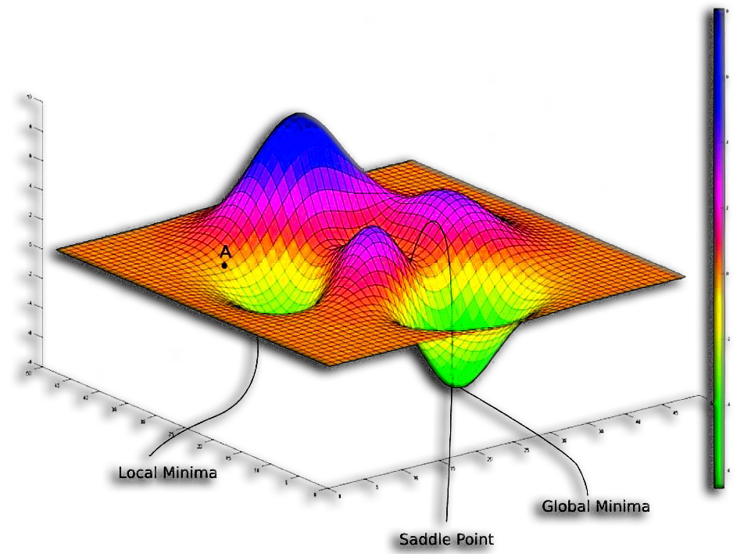
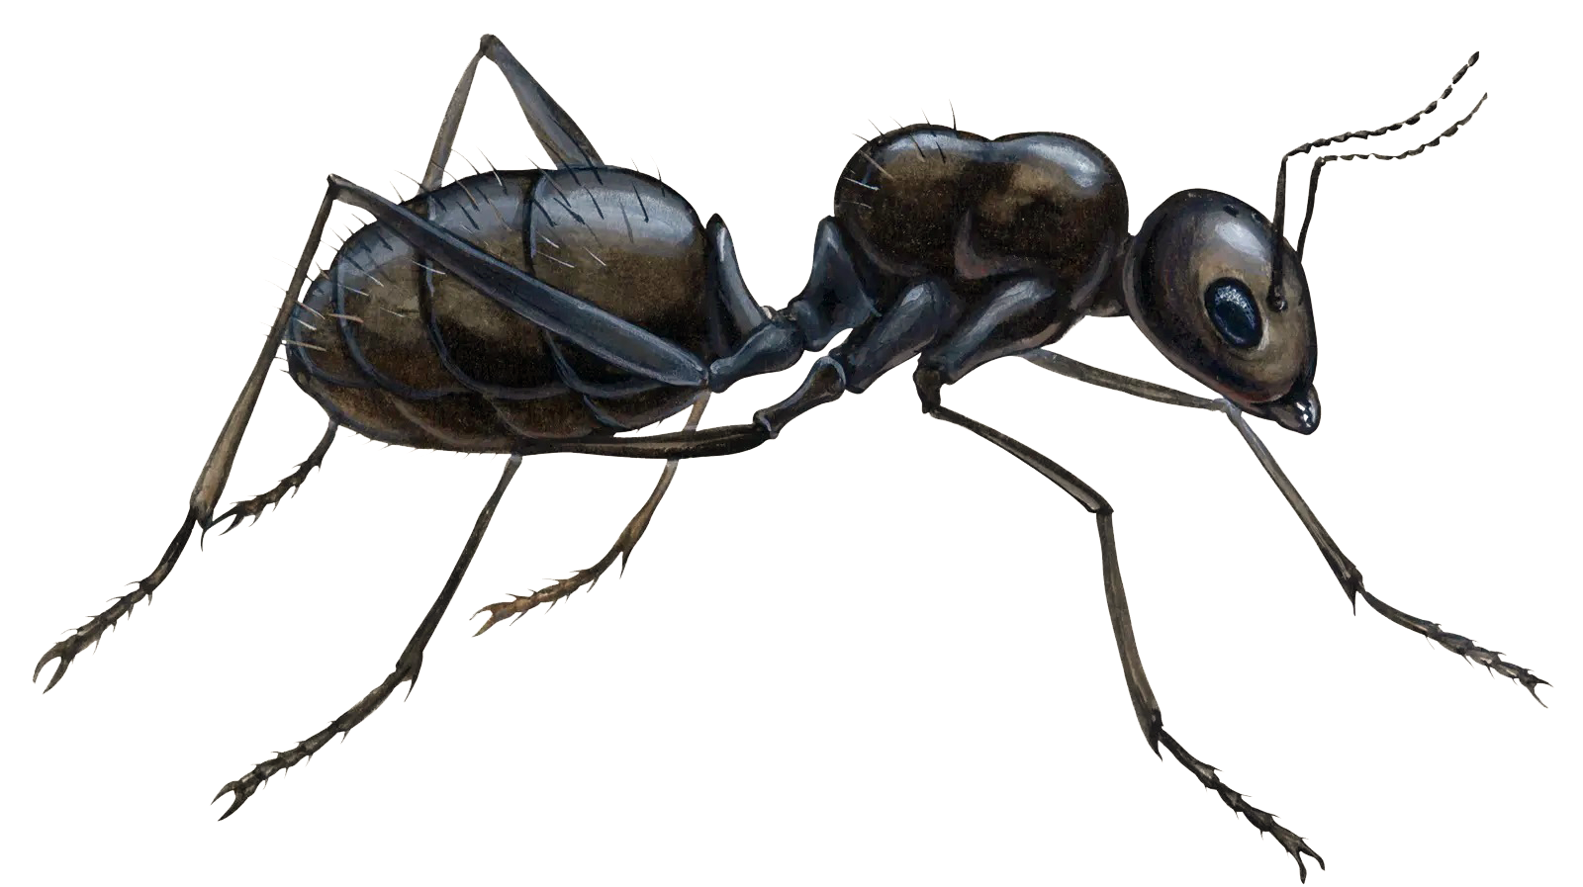
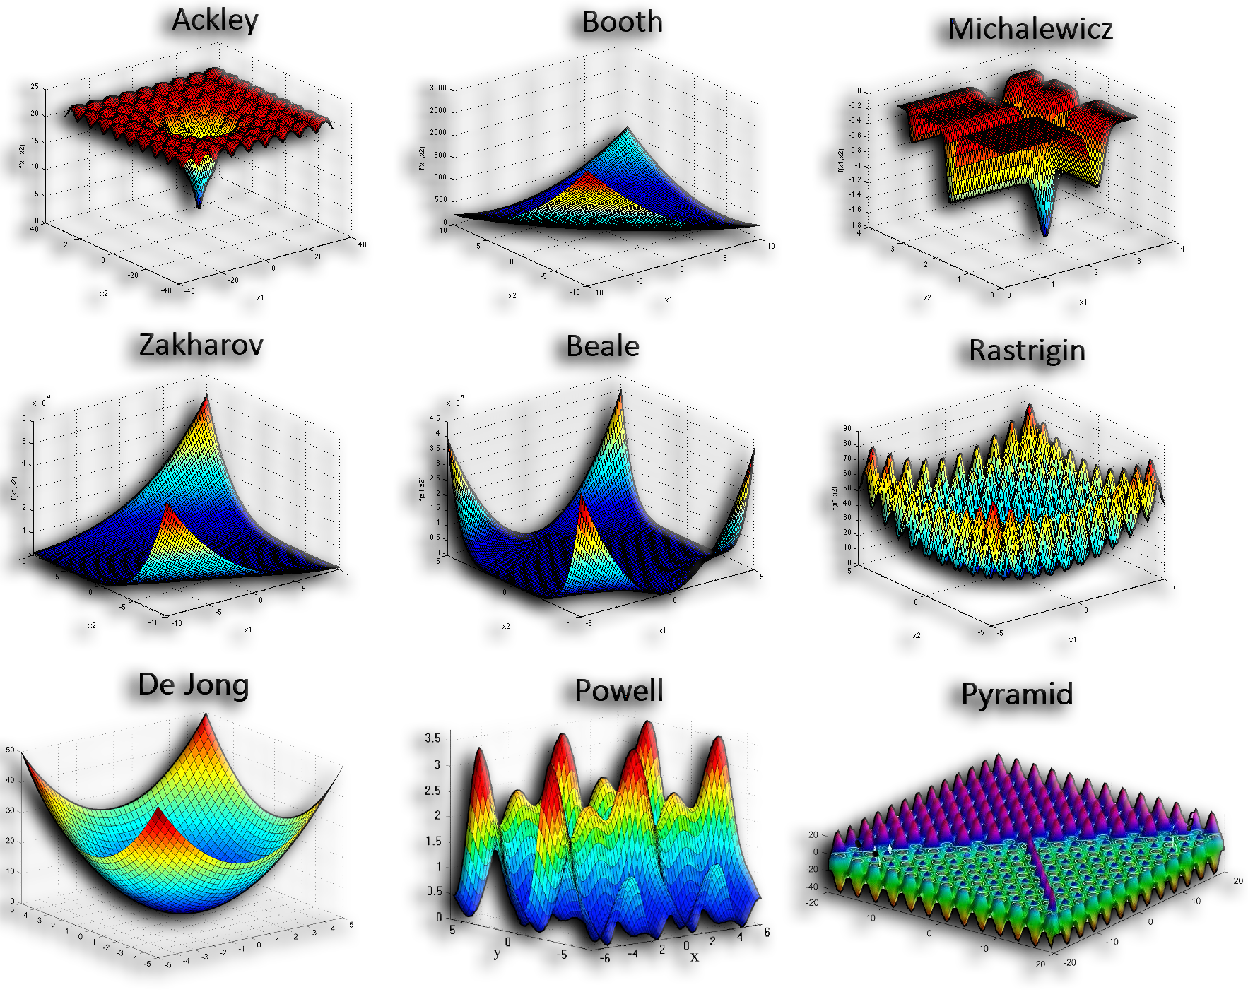
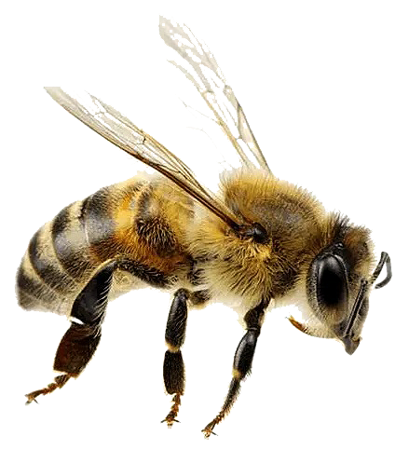

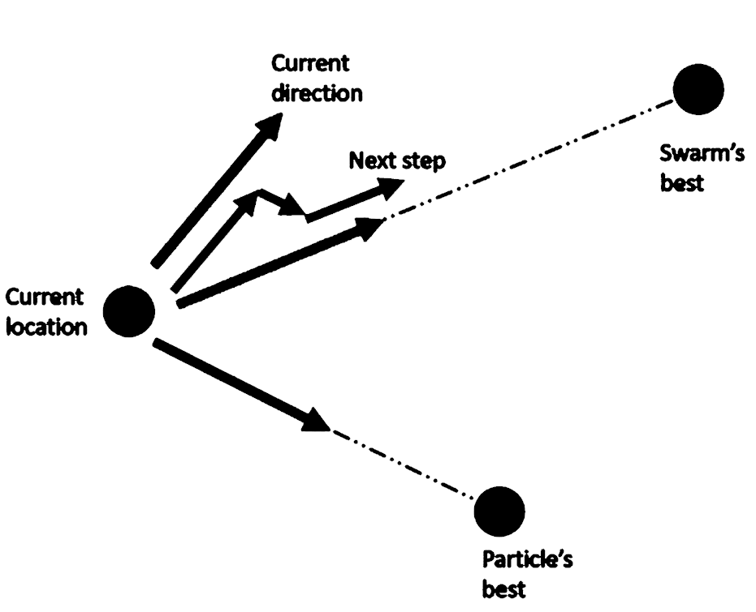
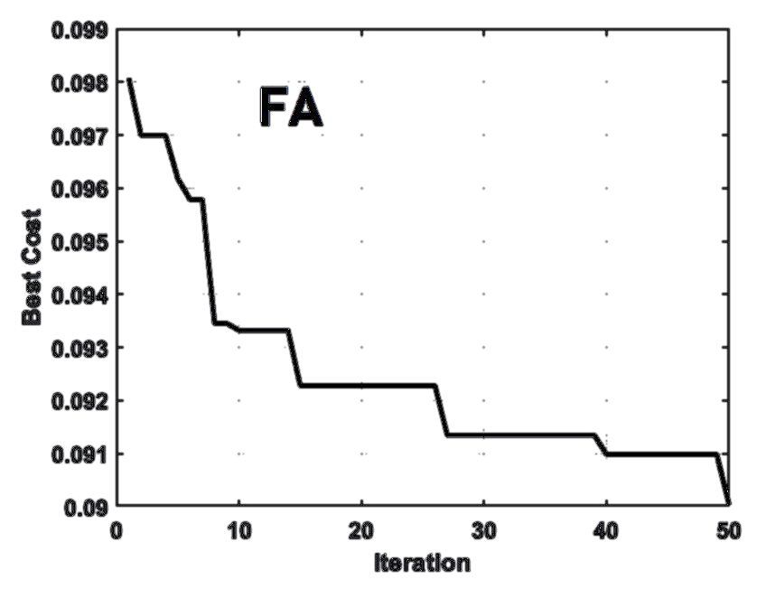
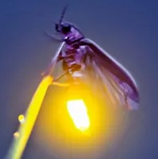
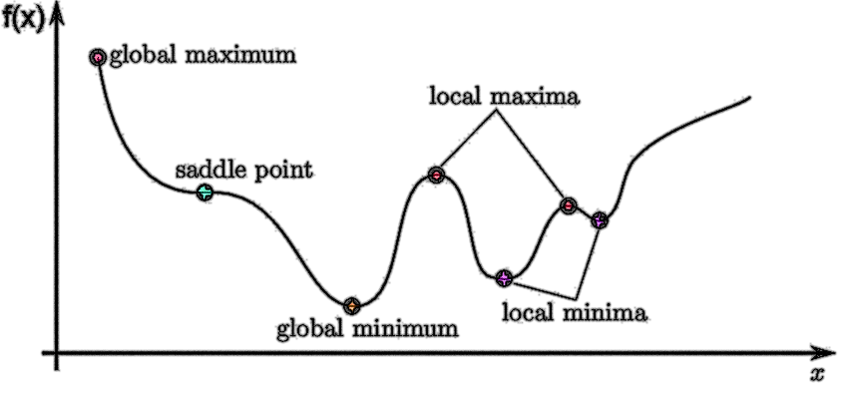

Metaheuristic Optimization: 4 Cutting-Edge Applications
Space-Time Warping by Firefly Algorithm (FA)
By: Seyed Muhammad Hossein Mousavi
2025

Slide 2
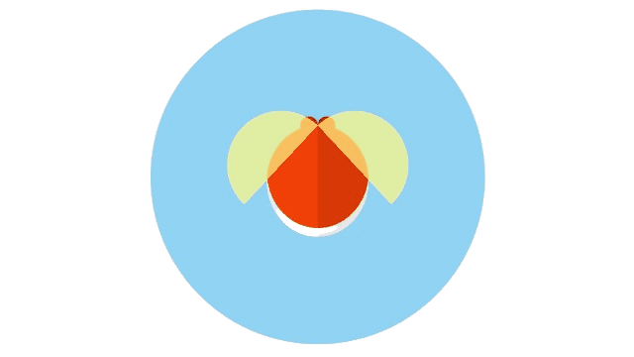

Outline:
Optimization
Optimization Problems
Protein Folding by Differential Evolution algorithm (DE)
Space-Time Warping by Firefly Algorithm (FA)
Exoplanetary Adaptation Simulation by Genetic Algorithm (GA)
Evolved Antenna Design by Particle Swarm Optimization algorithm (PSO)

Slide 3

Optimization Problems
Space-Time Warping by Firefly Algorithm (FA)
Space-Time: the four-dimensional fabric combining space and time where motion or energy can bend its geometry.
Space (real-world): the three-dimensional physical area where objects exist and move.
Space (in the course): the 2D coordinate system (x, y) where fireflies search for the best position.
Time (real world): the continuous flow of events from past to future, measuring change and motion.
Time (in the course): the iteration sequence showing how solutions evolve step by step during optimization.
The four dimensions are x, y, z (space), and time (t).
Fabric: the real world’s woven structure of space and time becomes the coded grid of positions and iterations forming the optimization landscape.
Warping: artificial distortion (bending) of space-time that shortens distance or time between two points.

Slide 4
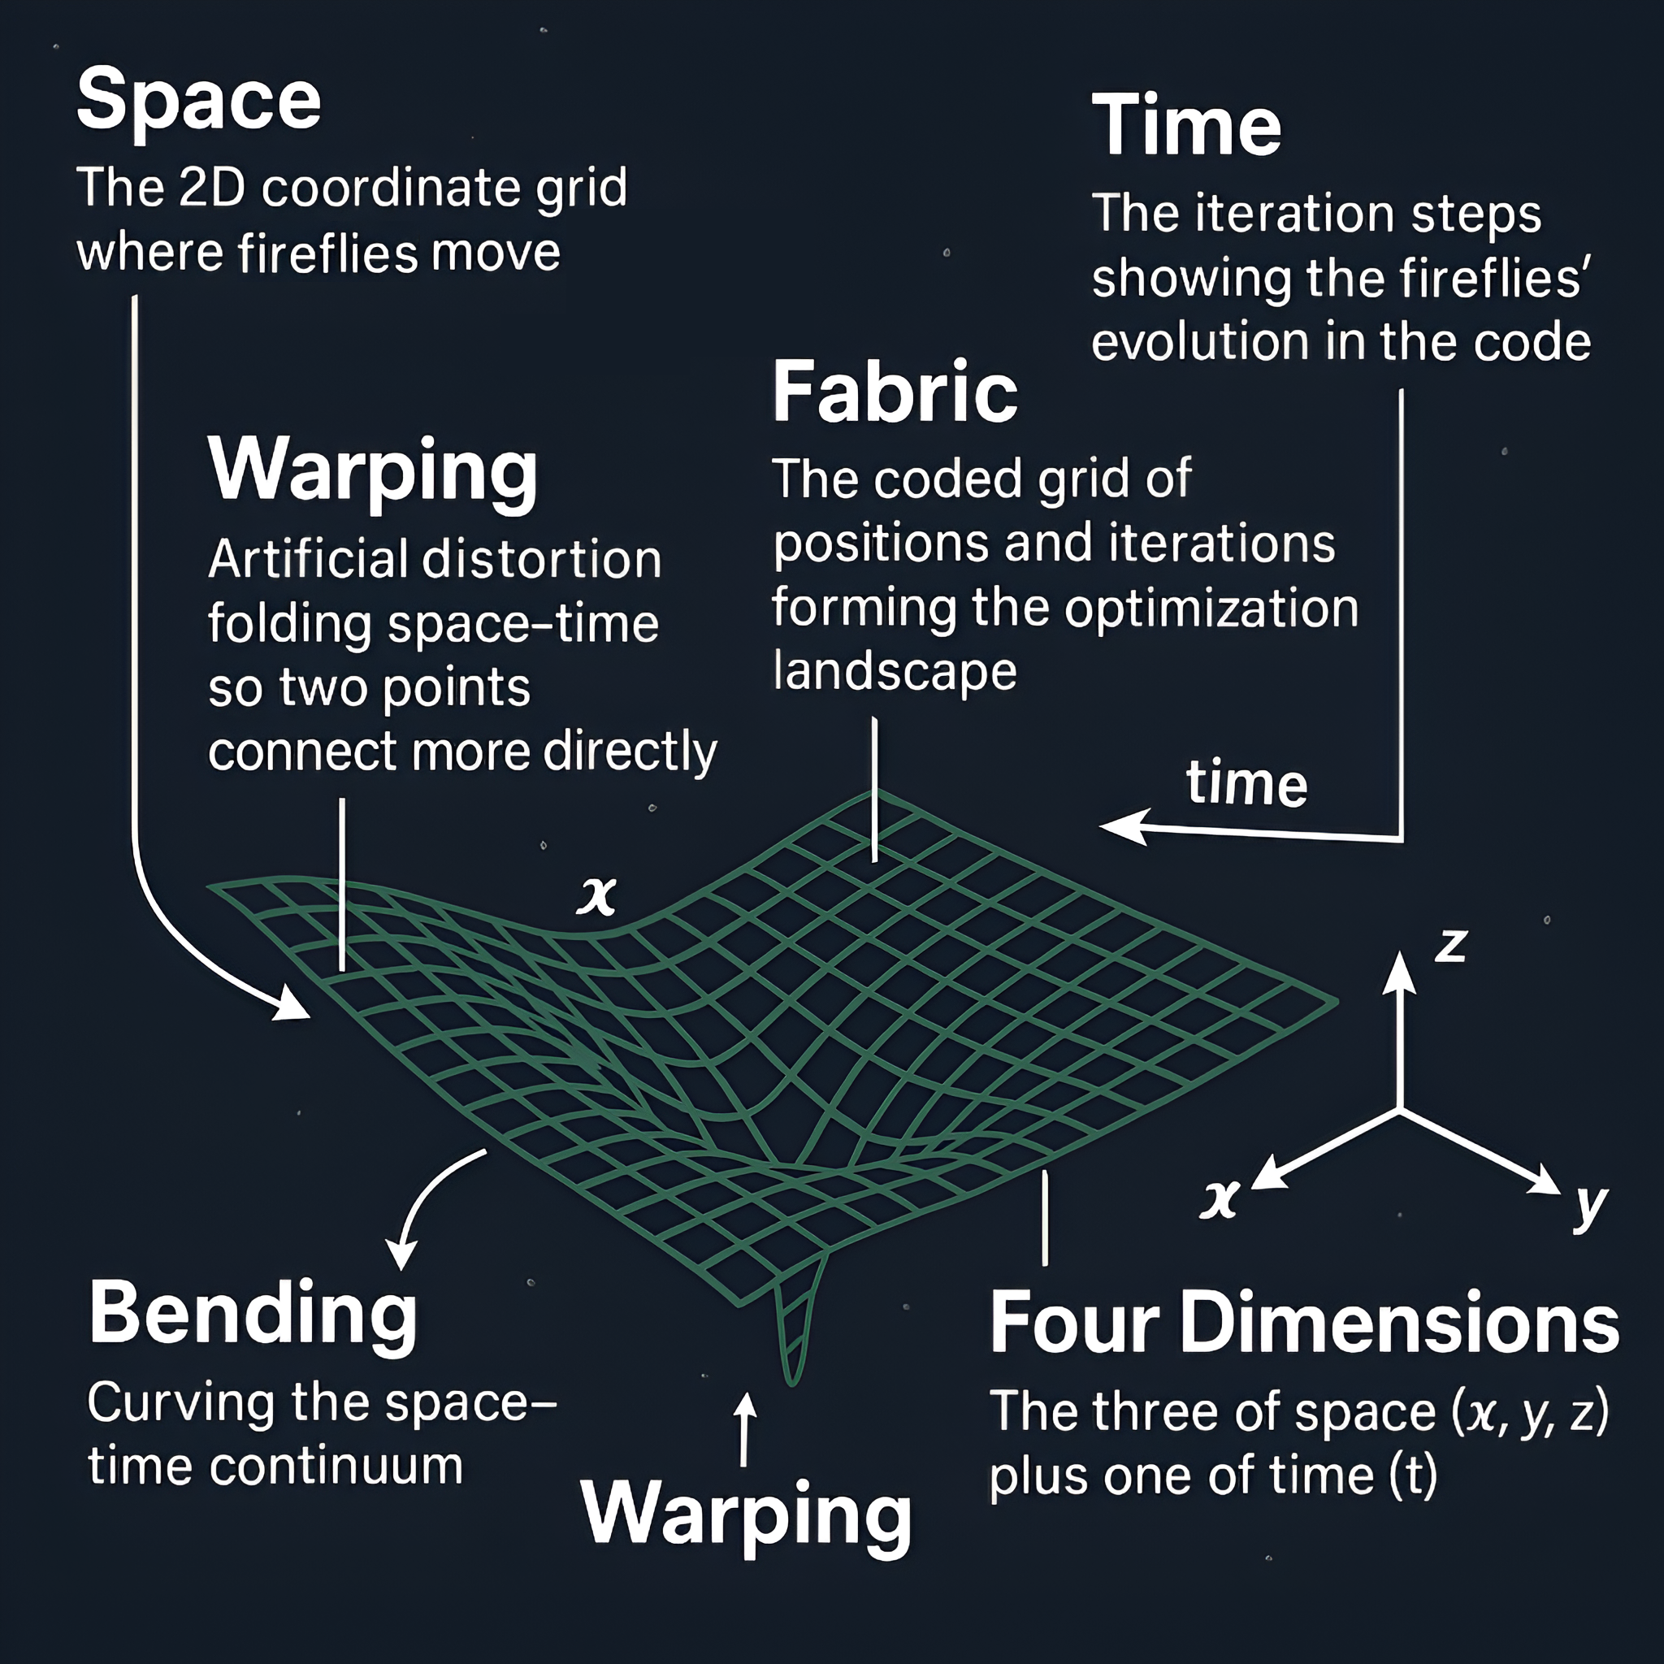
Optimization Problems
Space-Time Warping by Firefly Algorithm (FA)

Slide 5
Optimization Problems
Space-Time Warping by Firefly Algorithm (FA)
Geodesic: the shortest possible path between two points in curved space-time.
Bending Effort (λ/lambda bend): resistance against curvature, represents the energy needed to change a path’s geometry.
Warp Field: a simulated distortion field that alters how distances and time are measured.
Objective Function: mathematical rule measuring how costly or good a candidate solution is.
Firefly Algorithm: a metaheuristic inspired by fireflies’ light attraction, brighter ones attract others.
Attractiveness (β/beta): strength of movement toward a better (brighter) solution; decays with distance.
Absorption Coefficient (γ/gamma): controls how fast attractiveness decreases as distance grows.
Randomness (α): exploratory noise allowing escape from local minima.
Intensity: brightness equivalent of a solution’s quality (fitness).
Iteration: one full update cycle where all fireflies move and fitness is recalculated.
Global Best: the position with the lowest total cost found so far.
Distance Metric: Euclidean norm used to measure how far two solutions are.

Slide 6
Optimization Problems
Space-Time Warping by Firefly Algorithm (FA)
Our goal or objective here: To find the optimal point (path endpoint) that minimizes total energy, the combined cost of distance, bending, traversal effort, and warp-field energy.
So we do the process to bend space-time efficiently, finding a point (or path) where the energy cost to travel through warped space is minimal.
In simple terms: Finding the smoothest, most energy-efficient, least-curved path from a start point to a target in warped space-time.

Slide 7
Optimization Problems
Space-Time Warping by Firefly Algorithm (FA)
Why does it matter?
Space-time warping is important because it enables theoretical concepts like faster-than-light travel, gravitational navigation, and the discovery of minimum-energy paths in extreme physics environments.
By simulating it computationally, we gain insights into how curvature, energy, and distance interact, which is valuable for optimization, robotics, astrophysics, and even AI path planning.
Why is FA a better solver in this context?
Firefly Algorithm (FA) excels in solving this problem because it naturally balances exploration and exploitation, helping escape local minima in complex, warped landscapes.
Its distance-based attraction makes it ideal for space-time scenarios, where curvature and energy fields influence pathfinding non-linearly.

Slide 8
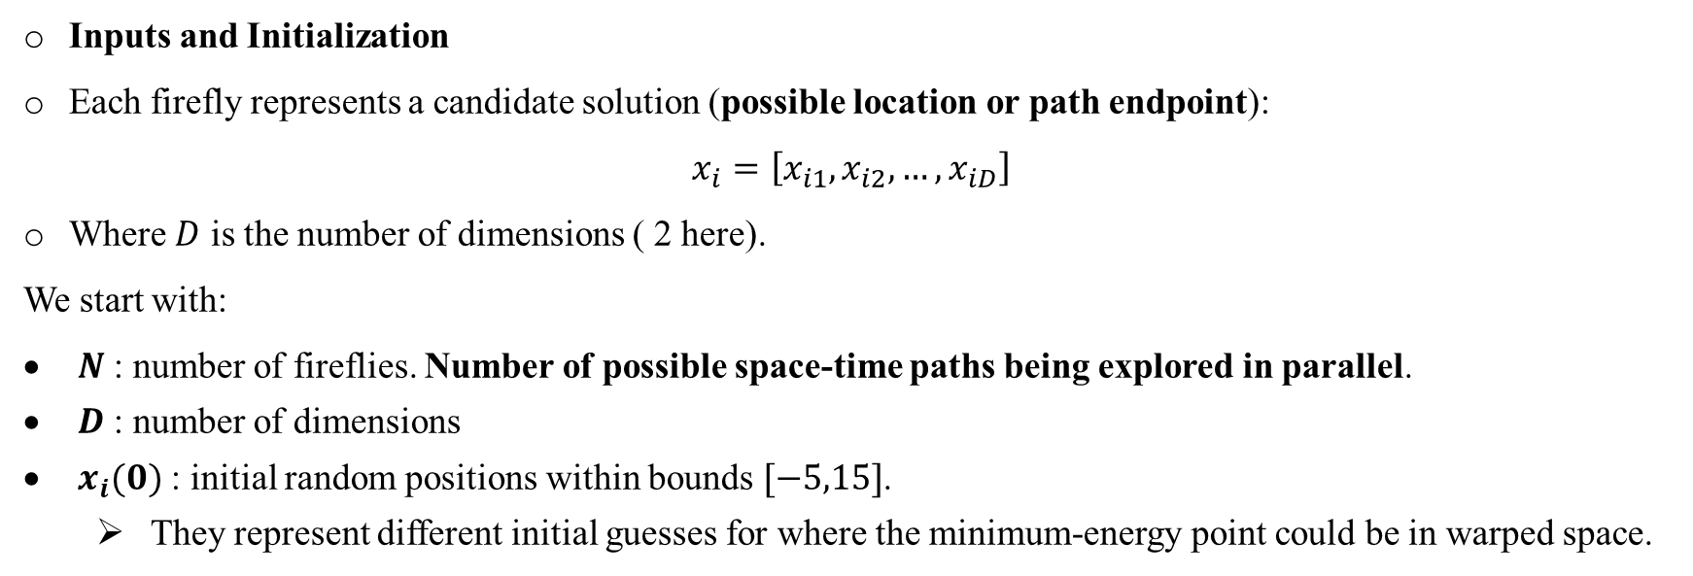
Optimization Problems
Space-Time Warping by Firefly Algorithm (FA)
Inputs and Initialization
Each firefly represents a candidate solution (possible location or path endpoint):
$$x_{i}=\left[x_{i1},x_{i2},…,x_{iD}\right]$$
Where $D$ is the number of dimensions ( 2 here).
We start with:
$N$ : number of fireflies. Number of possible space-time paths being explored in parallel.
$D$ : number of dimensions
$x_{i}(0)$ : initial random positions within bounds $[−5,15]$.
They represent different initial guesses for where the minimum-energy point could be in warped space.

Slide 9
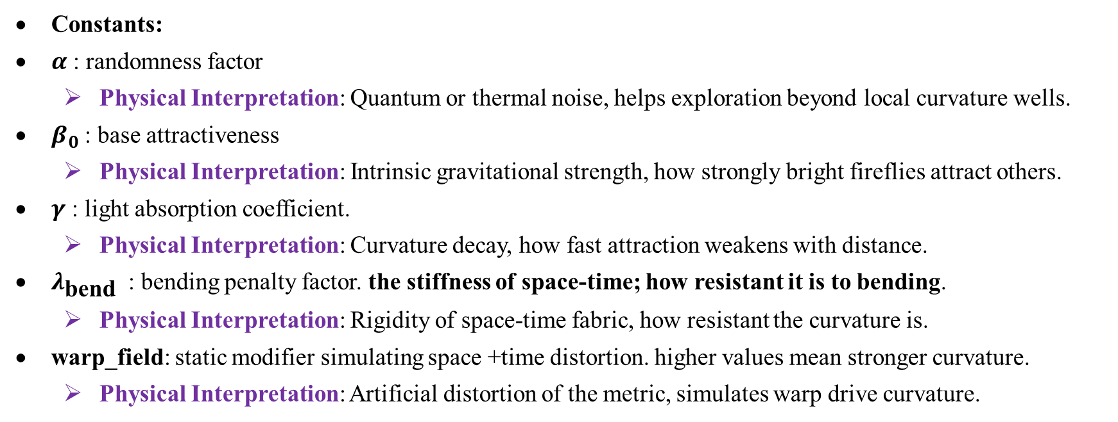
Optimization Problems
Space-Time Warping by Firefly Algorithm (FA)
Constants:
$α$ : randomness factor
Physical Interpretation: Quantum or thermal noise, helps exploration beyond local curvature wells.
$β_{0}$ : base attractiveness
Physical Interpretation: Intrinsic gravitational strength, how strongly bright fireflies attract others.
$γ$ : light absorption coefficient.
Physical Interpretation: Curvature decay, how fast attraction weakens with distance.
$λ_{\text{bend} }$ : bending penalty factor. the stiffness of space-time; how resistant it is to bending.
Physical Interpretation: Rigidity of space-time fabric, how resistant the curvature is.
warp_field: static modifier simulating space +time distortion. higher values mean stronger curvature.
Physical Interpretation: Artificial distortion of the metric, simulates warp drive curvature.

Slide 10
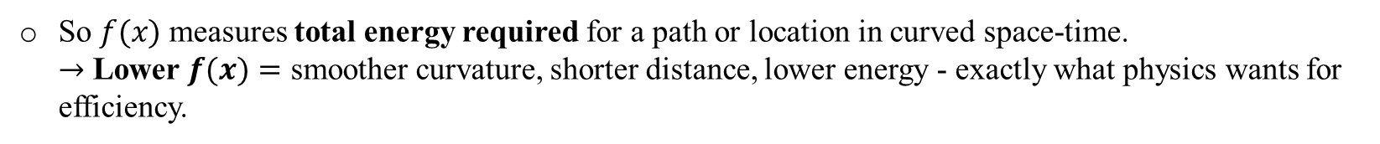
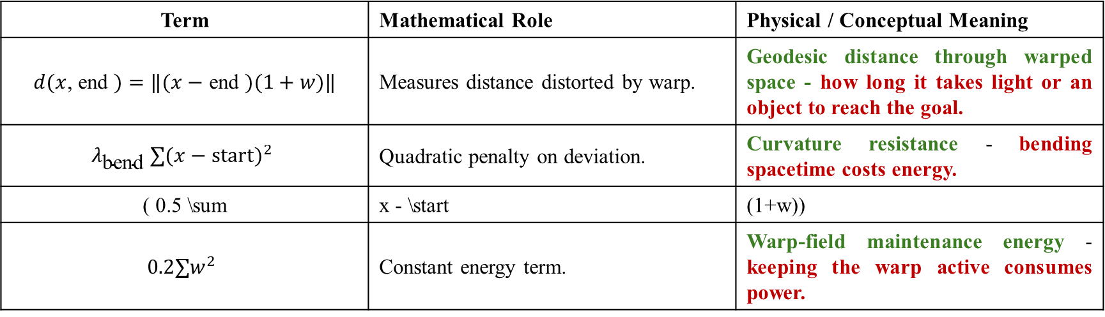
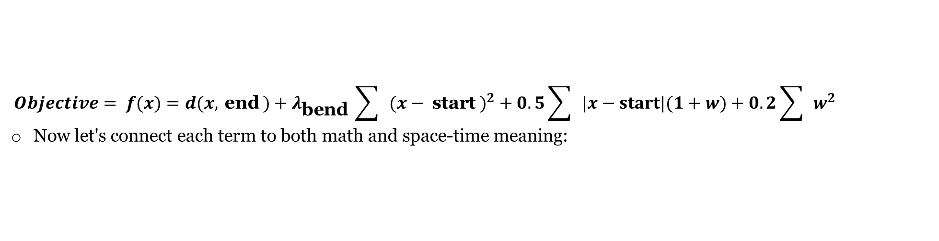
Optimization Problems
Space-Time Warping by Firefly Algorithm (FA)
Objective Function:
$$Objective= f(x)=d(x, \text{end} )+λ_{\text{bend} }\sum{ }(x− \text{start} )^{2}+0.5\sum{ }|x−start|(1+w)+0.2\sum{ }w^{2}$$
Now let's connect each term to both math and space-time meaning:
Term | Mathematical Role | Physical / Conceptual Meaning
$d(x$, end $)=‖(x−$ end $)(1+w)‖$ | Measures distance distorted by warp. | Geodesic distance through warped space - how long it takes light or an object to reach the goal.
$$λ_{\text{bend} }∑(x−start)^{2}$$ | Quadratic penalty on deviation. | Curvature resistance - bending spacetime costs energy.
( 0.5 \sum | x - \start | (1+w))
$$0.2∑w^{2}$$ | Constant energy term. | Warp-field maintenance energy - keeping the warp active consumes power.
So $f(x)$ measures total energy required for a path or location in curved space-time. $→$ Lower $f(x)=$ smoother curvature, shorter distance, lower energy - exactly what physics wants for efficiency.

Slide 11
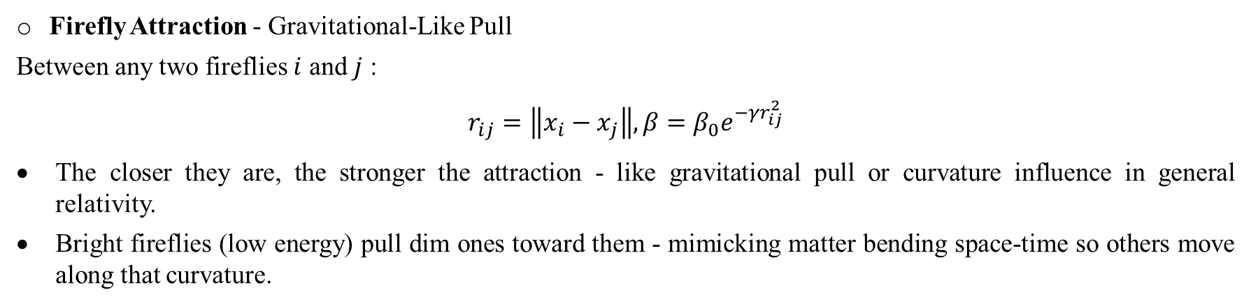
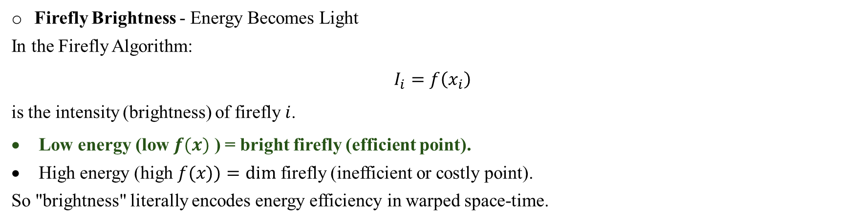
Optimization Problems
Space-Time Warping by Firefly Algorithm (FA)
Firefly Brightness - Energy Becomes Light
In the Firefly Algorithm:
$$I_{i}=f\left(x_{i}\right)$$
is the intensity (brightness) of firefly $i$.
Low energy (low $f(x)$ ) = bright firefly (efficient point).
High energy (high $f(x))=dim$ firefly (inefficient or costly point).
So "brightness" literally encodes energy efficiency in warped space-time.
Firefly Attraction - Gravitational-Like Pull
Between any two fireflies $i$ and $j$ :
$$r_{ij}=\left\|x_{i}−x_{j}\right\|, β=β_{0}e^{−γr_{ij}^{2}}$$
The closer they are, the stronger the attraction - like gravitational pull or curvature influence in general relativity.
Bright fireflies (low energy) pull dim ones toward them - mimicking matter bending space-time so others move along that curvature.

Slide 12
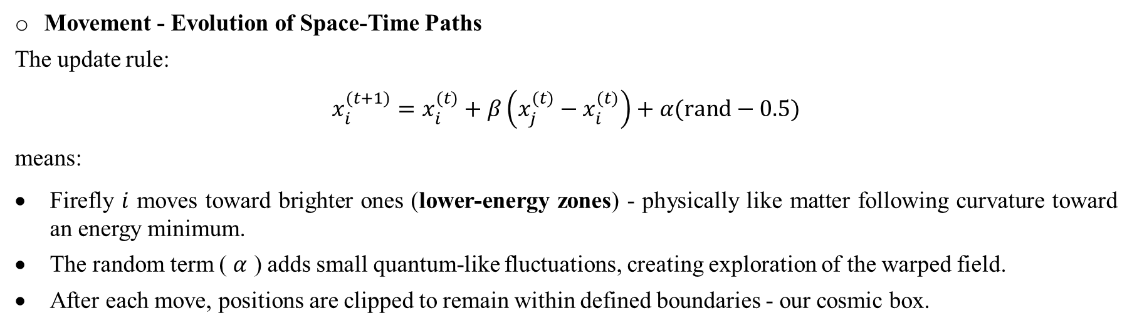
Optimization Problems
Space-Time Warping by Firefly Algorithm (FA)
Movement - Evolution of Space-Time Paths
The update rule:
$$x_{i}^{(t+1)}=x_{i}^{(t)}+β\left(x_{j}^{(t)}−x_{i}^{(t)}\right)+α(rand−0.5)$$
means:
Firefly $i$ moves toward brighter ones (lower-energy zones) - physically like matter following curvature toward an energy minimum.
The random term ( $α$ ) adds small quantum-like fluctuations, creating exploration of the warped field.
After each move, positions are clipped to remain within defined boundaries - our cosmic box.

Slide 13
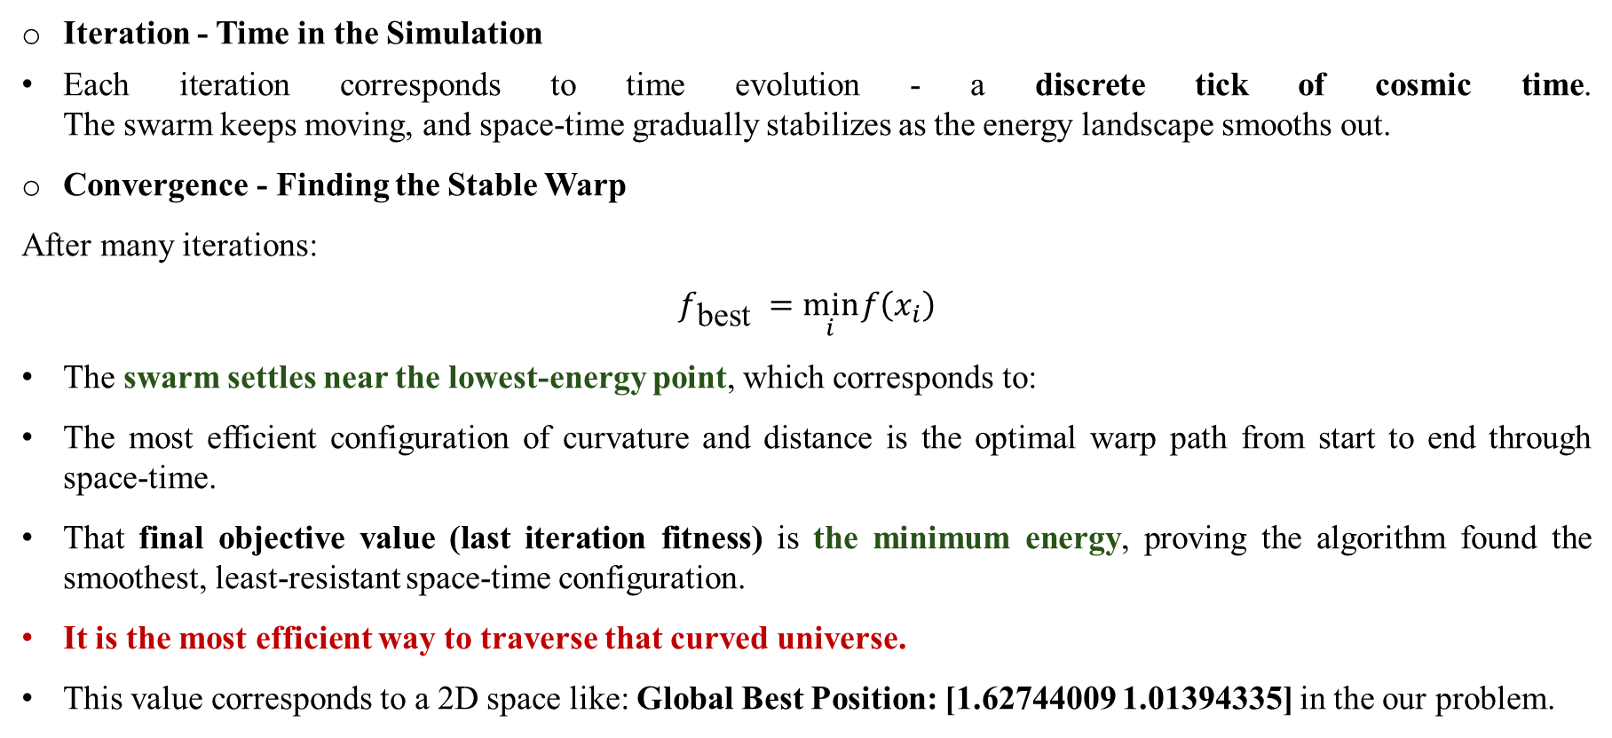
Optimization Problems
Space-Time Warping by Firefly Algorithm (FA)
Iteration - Time in the Simulation
Each iteration corresponds to time evolution - a discrete tick of cosmic time. The swarm keeps moving, and space-time gradually stabilizes as the energy landscape smooths out.
Convergence - Finding the Stable Warp
After many iterations:
$$f_{\text{best} }=\min_{i} f\left(x_{i}\right)$$
The swarm settles near the lowest-energy point, which corresponds to:
The most efficient configuration of curvature and distance is the optimal warp path from start to end through space-time.
That final objective value (last iteration fitness) is the minimum energy, proving the algorithm found the smoothest, least-resistant space-time configuration.
It is the most efficient way to traverse that curved universe.
This value corresponds to a 2D space like: Global Best Position: [1.62744009 1.01394335] in the our problem.

Slide 14
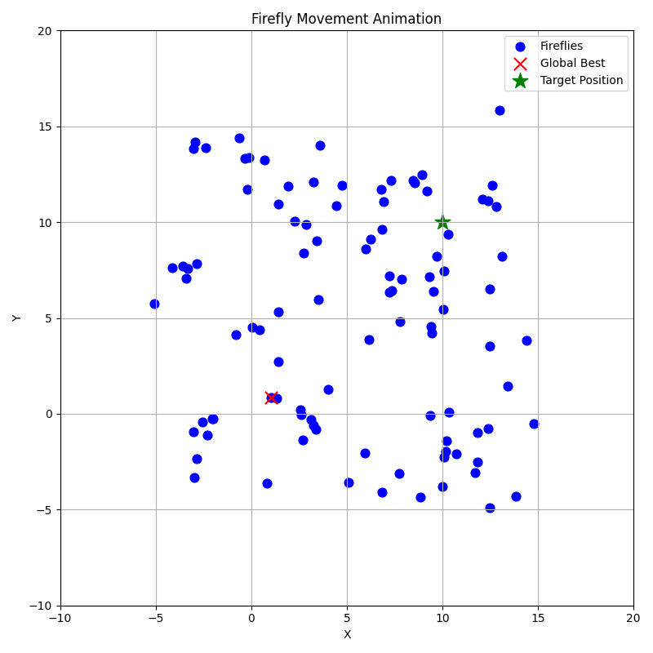
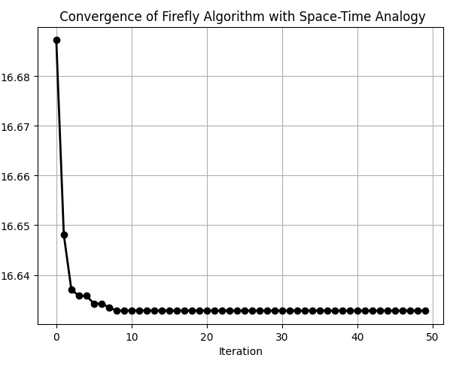
Optimization Problems
Space-Time Warping by Firefly Algorithm (FA)

